Slide 1
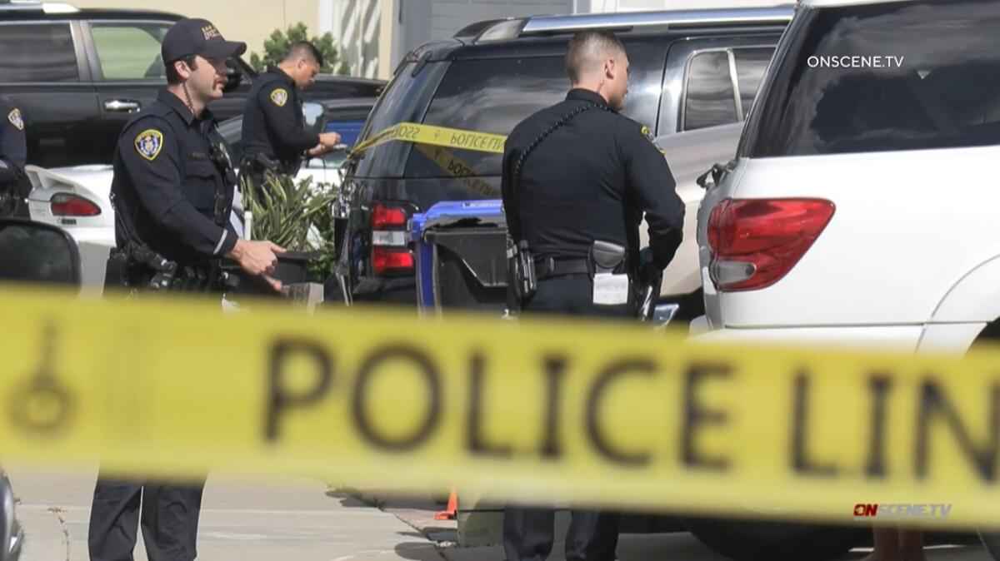
Crime Rate Data Analysis in Los Angeles
Presented by-
1. Gnaneswar Maram - ZE24010
2. Monika Alla - RS82696

Slide 2
Problem Statement
Crime Analysis for Law Enforcement: To help law enforcement allocate resources more efficiently and anticipate crime hotspots for proactive policing, divide Los Angeles communities based on the severity of crimes. This can be done by applying sophisticated data analysis tools.
Safe Housing Insights: Offer insightful information on housing and urban planning that helps to identify safe neighborhoods and encourage the creation of residential areas that put the safety of their residents first.
Making Decisions Based on Data: Use clustering and machine learning techniques to find relevant trends in the LA crime dataset. This will enable residents and city authorities to make decisions that will lead to safer communities.

Slide 3
Data Collection
The data collection methods involve retrieving and processing information from Data.gov
https://catalog.data.gov/dataset/crime-data-from-2020-to-present/resource/5eb6507e-fa82-4595-a604-023f8a326099
All these records enables crime analysis
Focuses mainly on the historical data regarding crimes in the LA.

Slide 4
Dataset
The LA crime dataset encompasses a vast array of information, including arrest specifics, demographic details, area names, crime descriptions, weapon description, premise description, locations, and timestamps.
•Number of rows: 892934
•Number of columns: 28
Columns :
DR_NO', 'Date Rptd', 'DATE OCC', 'TIME OCC', 'AREA', 'AREA NAME', 'Rpt Dist No', 'Part 1-2', 'Crm Cd', 'Crm Cd Desc', 'Mocodes', 'Vict Age', 'Vict Sex', 'Vict Descent', 'Premis Cd', 'Premis Desc', 'Weapon Used Cd', 'Weapon Desc', 'Status', 'Status Desc', 'Crm Cd 1', 'Crm Cd 2', 'Crm Cd 3', 'Crm Cd 4', 'LOCATION', 'Cross Street', 'LAT', 'LON'

Slide 5
Analysis Methods
Programming Languages: Python is the main language used for analysis and data processing.
Libraries and Frameworks: For data processing, analysis, statistical computations, visualization, and geospatial representation, use tools like PySpark, Pandas, NumPy, Matplotlib, Seaborn, geopandas, and Folium.
Phases include data intake, data storage, data processing, clustring, data analysis, and data visualization are typically included in the big data project lifecycle. These phases are implemented appropriately in the context of our LA crime analysis study.

Slide 6
Analysis/Results
Using data from the LAPD, we have developed a model to monitor crimes and their severity based on your project's scope.
Comprehending the Outcomes: evaluated the relevance and real-world applications of the patterns and insights found in the data. We were able to draw significant findings and provide the public with well-informed advice regarding the crimes by carefully analyzing the results and we interpreted the saftest area to live.

Slide 7
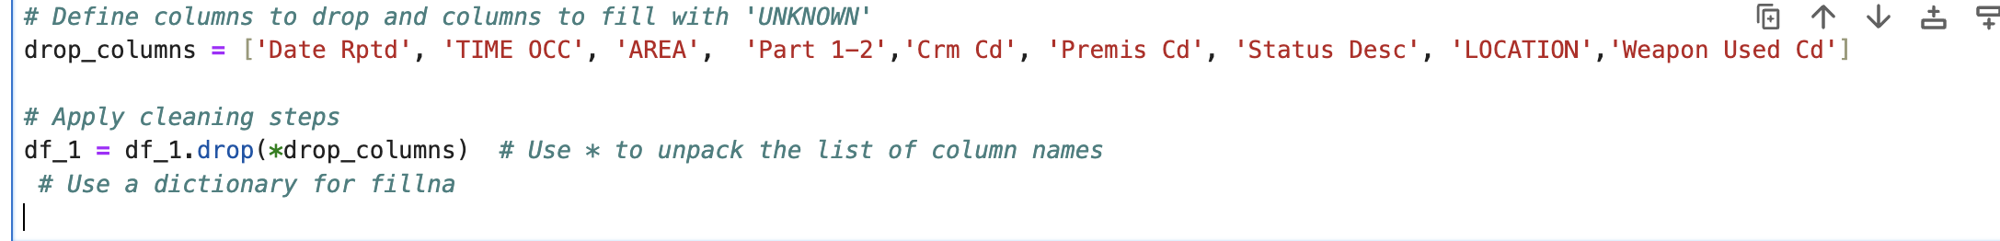
Pre - Processing
Dropping columns :
We have dropped some of the columns as we are not using in our analysis.
Finding missing values:
Vict Sex 118301
Premis Cd 10
Premis Desc 548
Weapon Used Cd 5833
Weapon Desc 5833

Slide 8
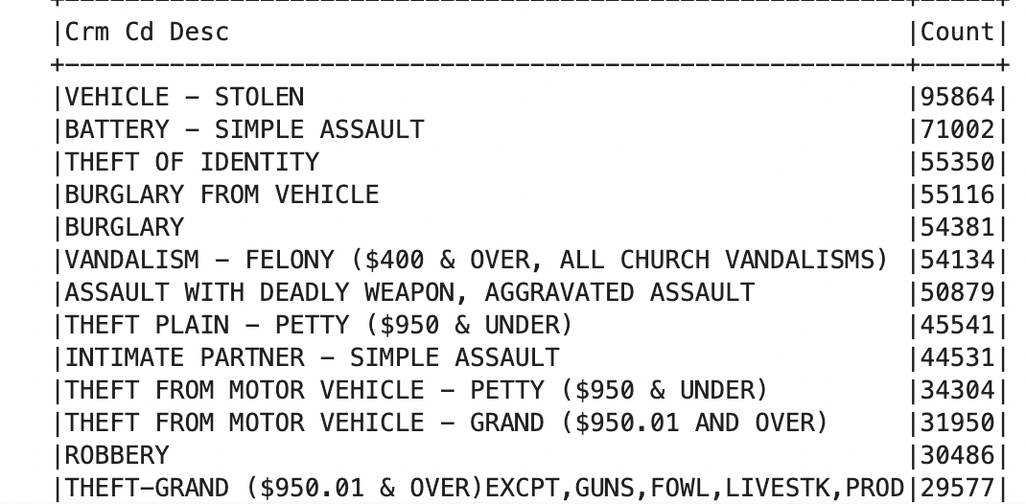
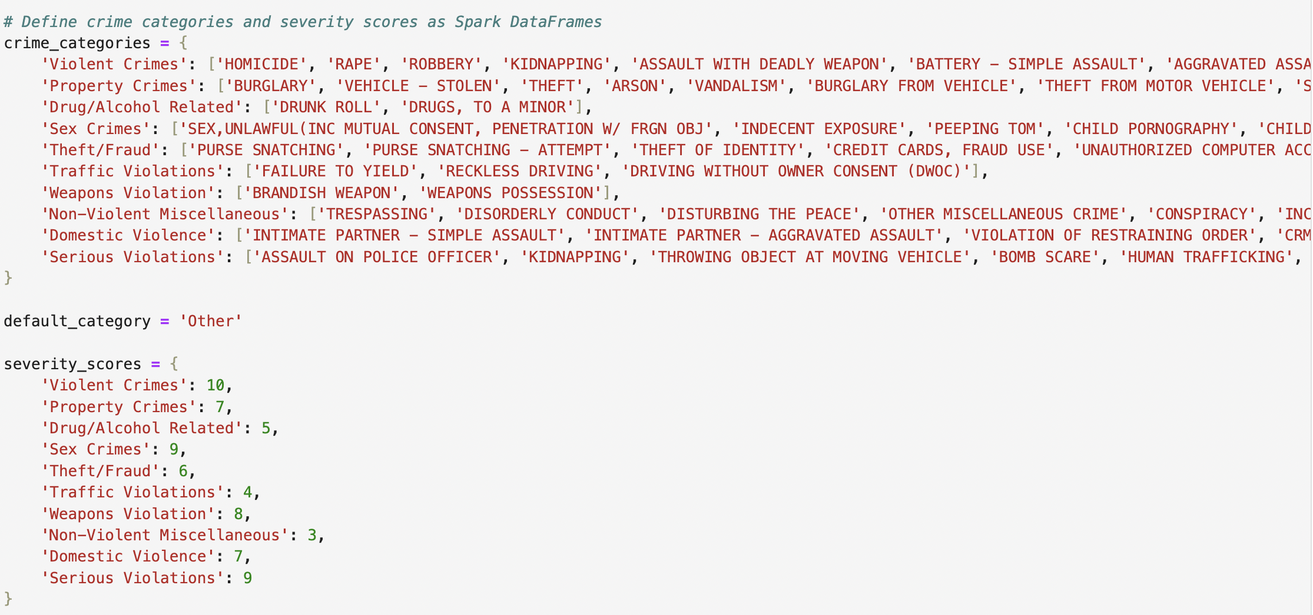
Crime description:
Crime description:

Slide 9
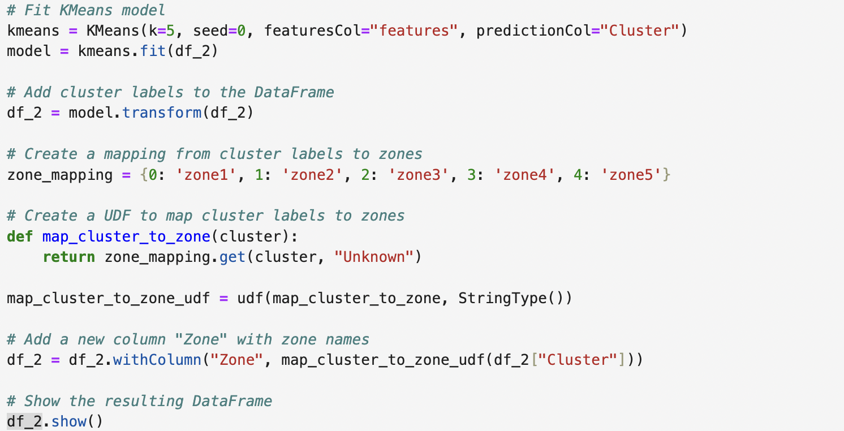
Zone Clustering
Based on the LAT and LON we have clustered our data into the Zones using KMEANS

Slide 10
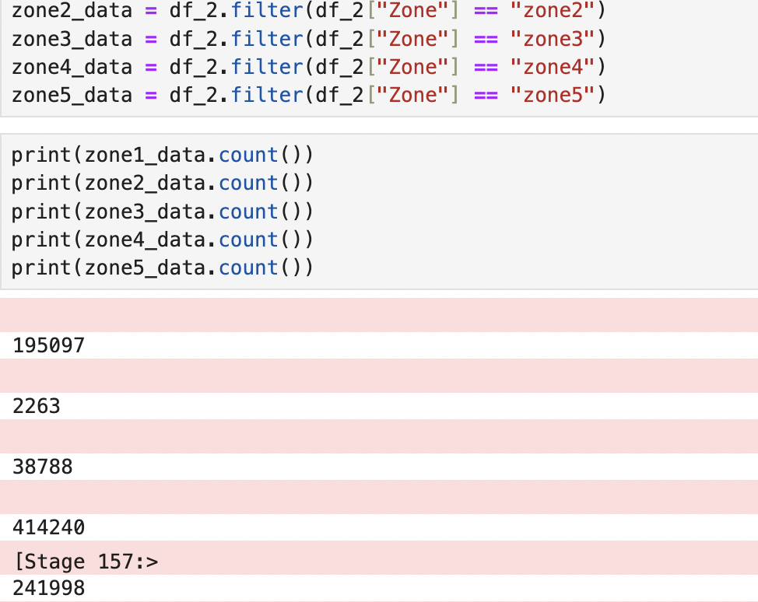
Based on the zone these are the crime distrubutions

Slide 11
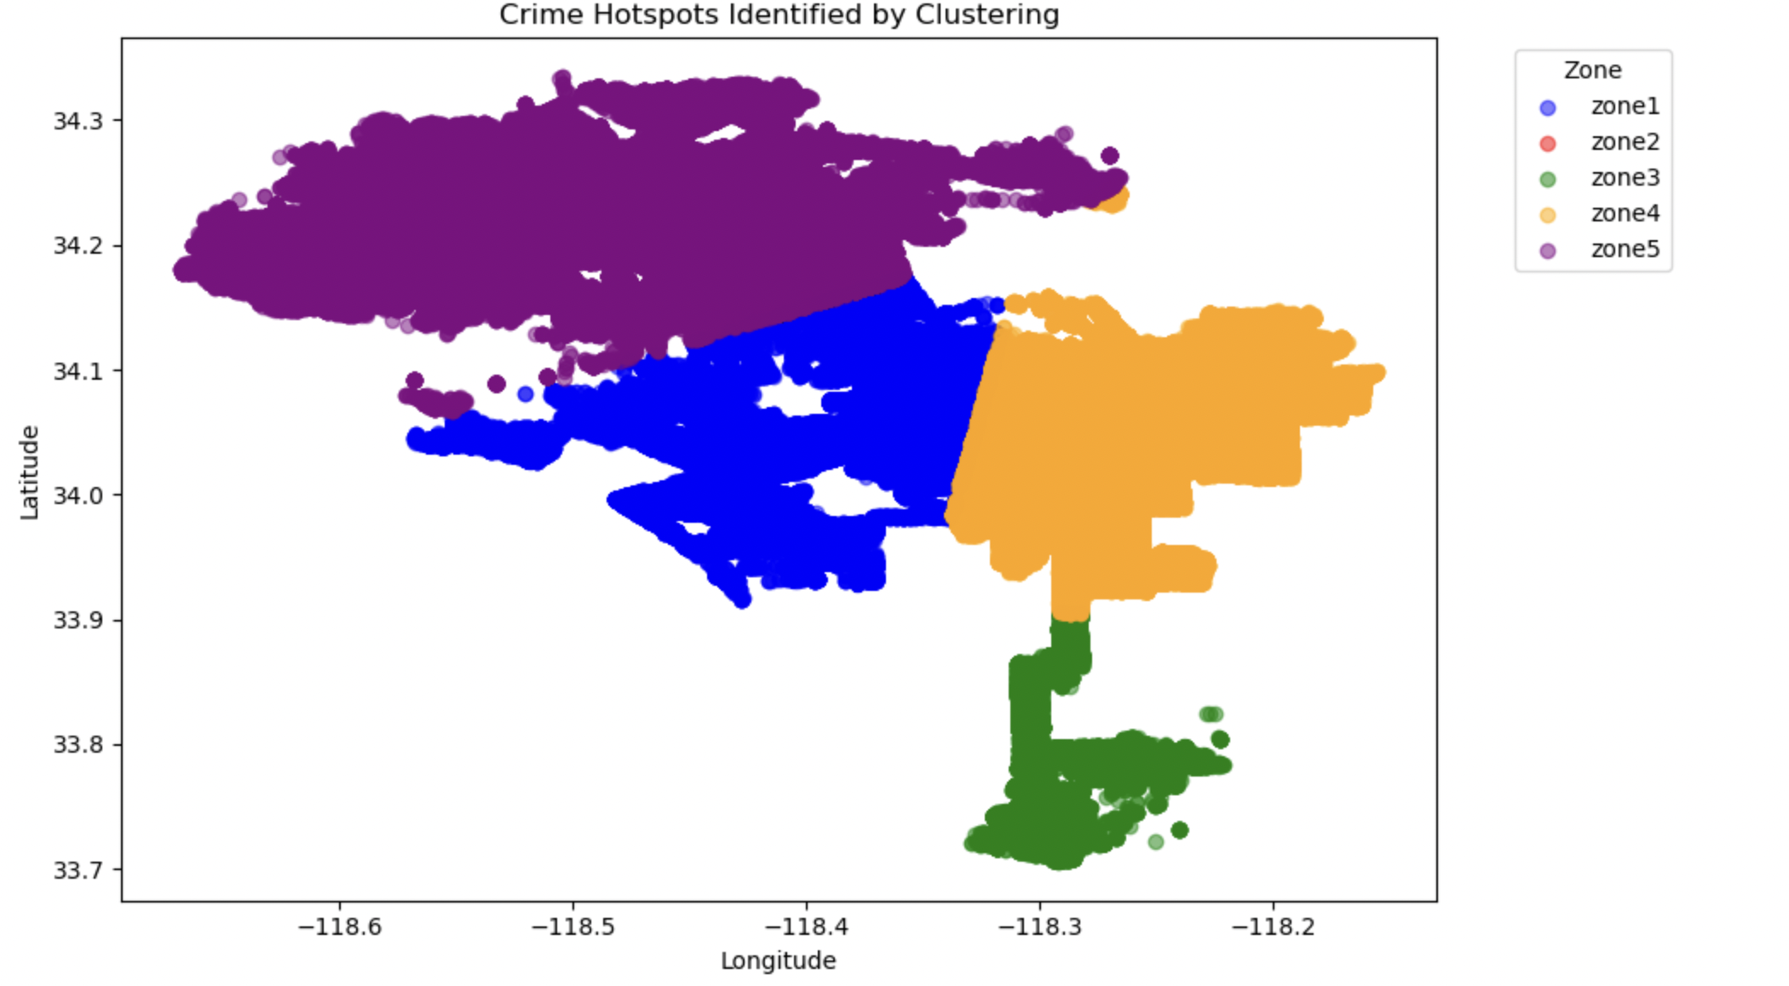

Slide 12
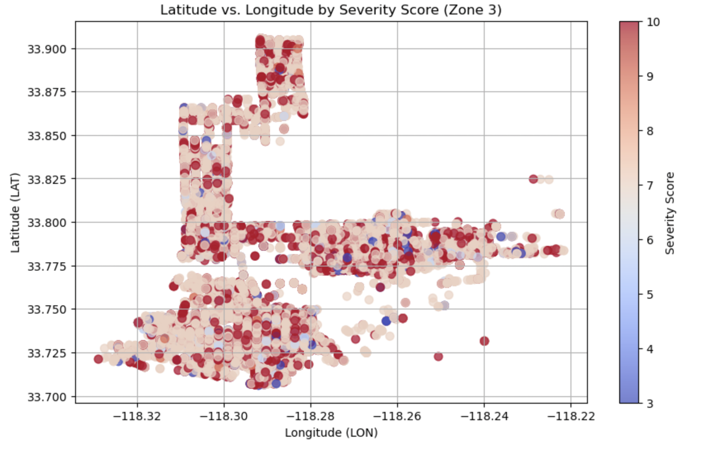
We have choosen Zone 3 for further Analysis

Slide 13
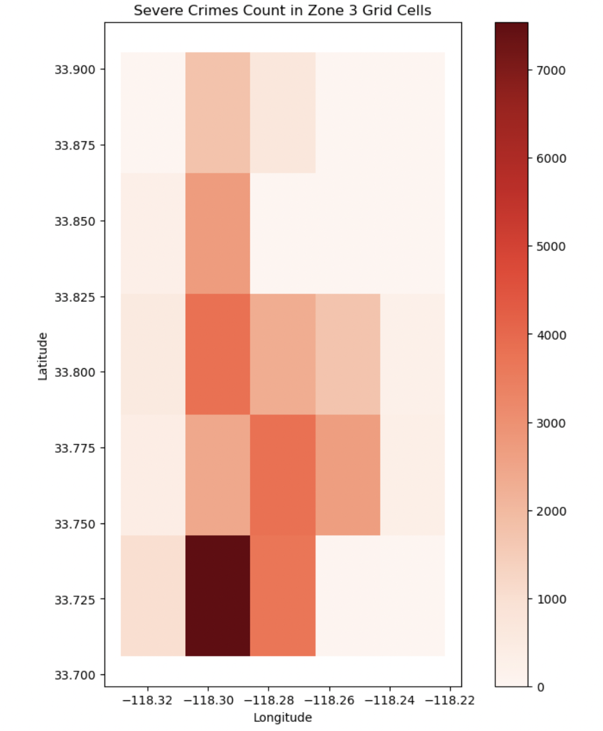
Data Collection

Slide 14
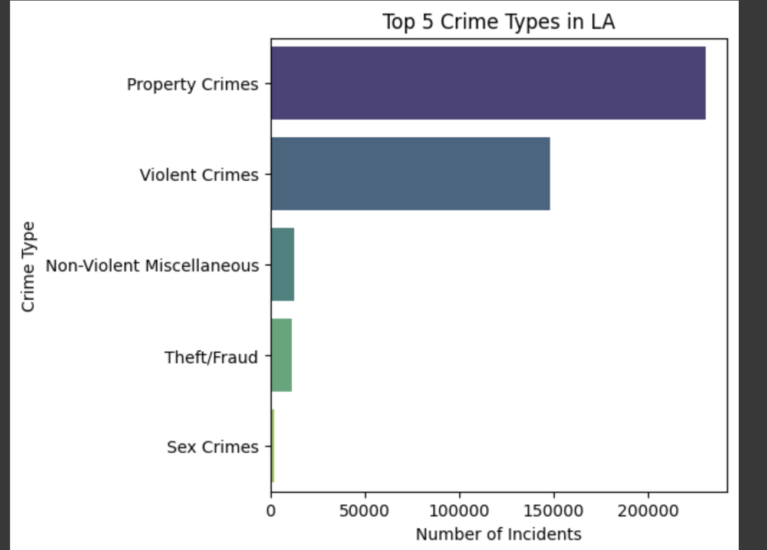
Data Visualization

Slide 15
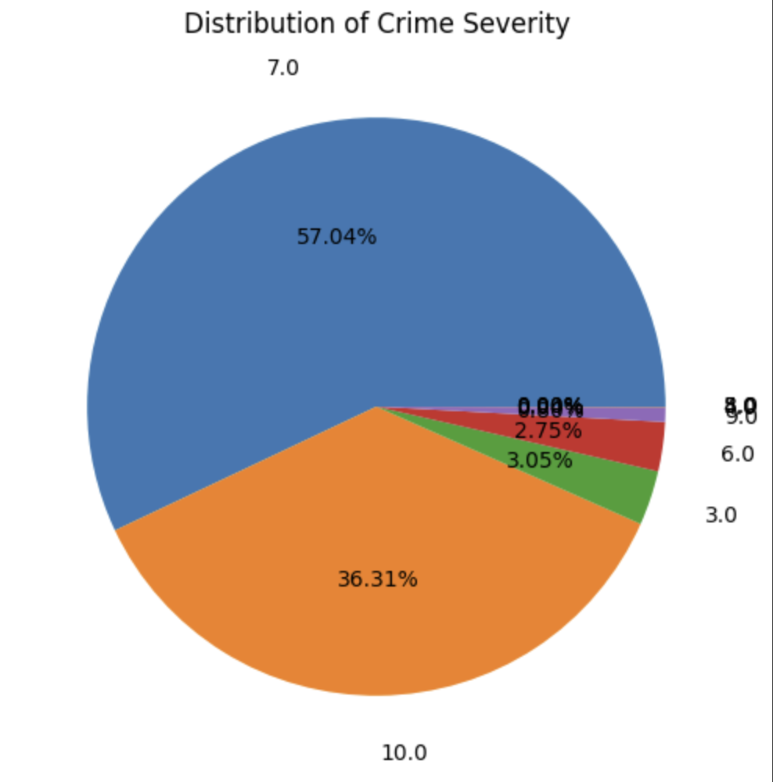
'Violent Crimes': 10,
'Property Crimes': 7,
'Drug/Alcohol Related': 5,
'Sex Crimes': 9,
'Theft/Fraud': 6,
'Traffic Violations': 4,
'Weapons Violation': 8,
'Non-Violent Miscellaneous': 3,
'Domestic Violence': 7,
'Serious Violations': 9

Slide 16
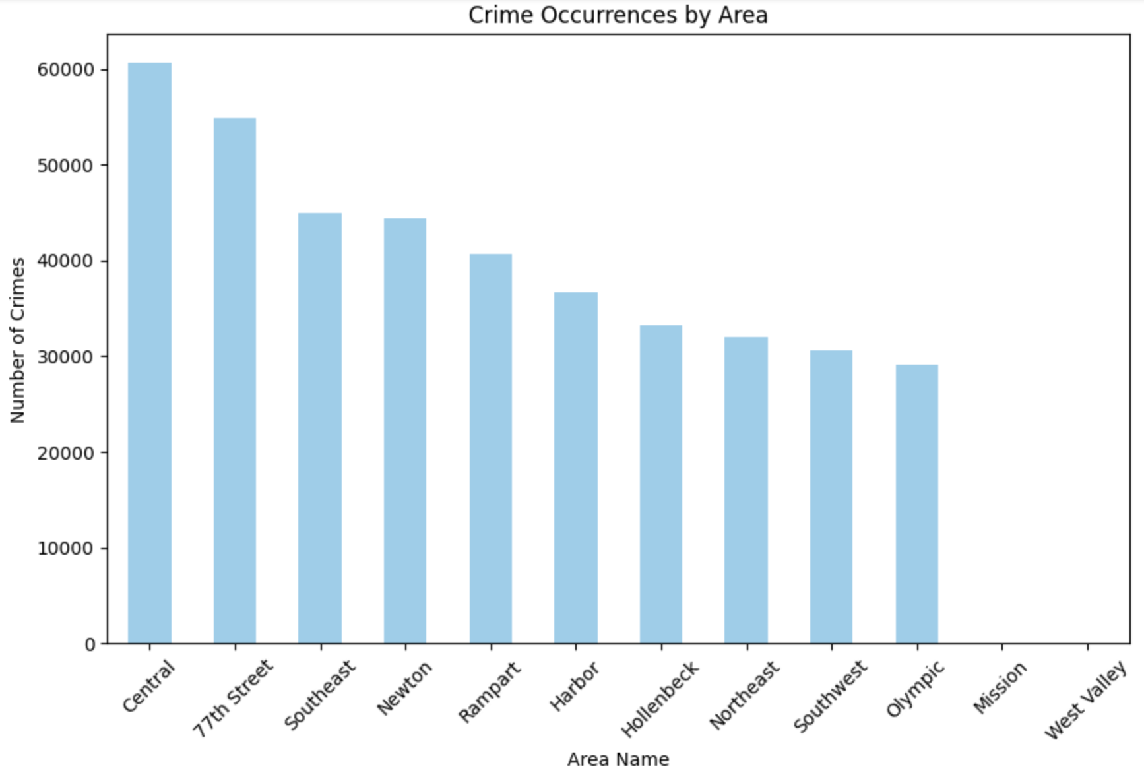

Slide 17
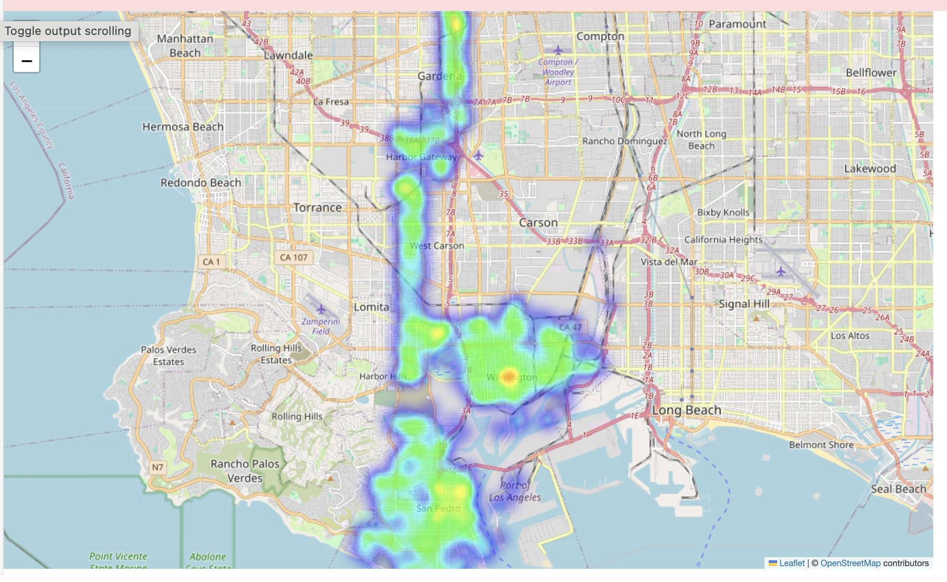
Using Folium

Slide 18
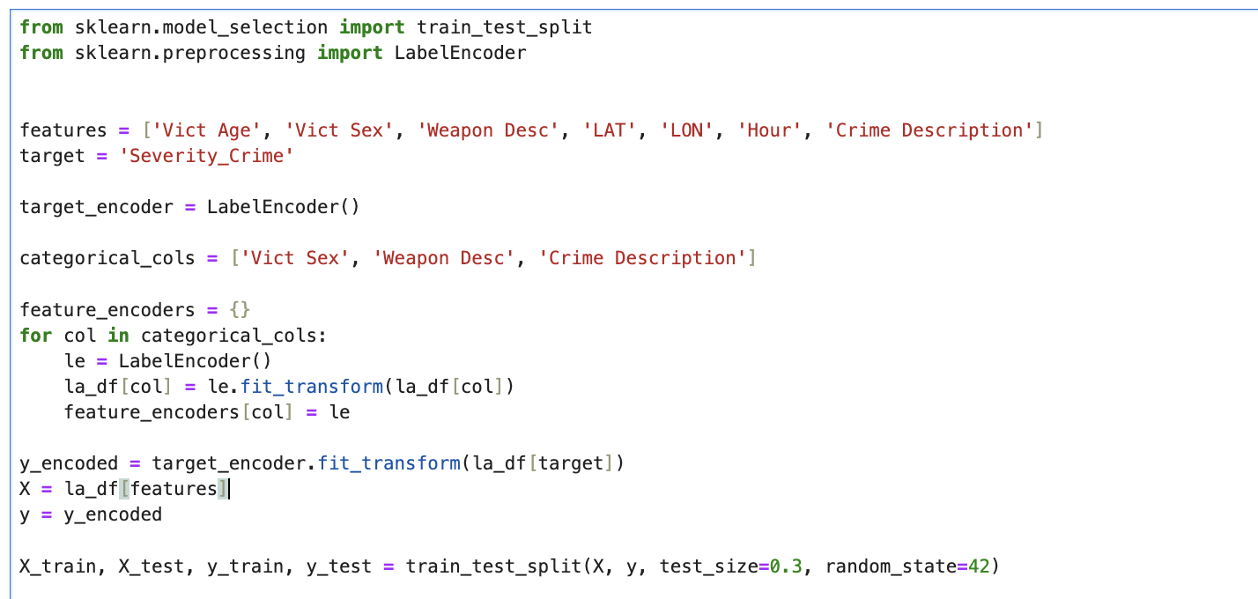
Modelling

Slide 19
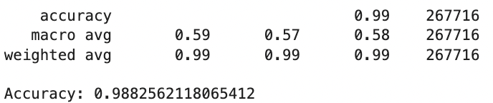
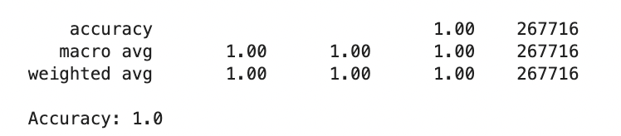
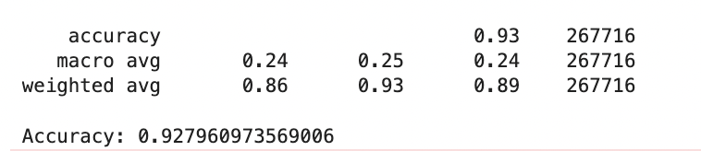
Logistic Regression
Decision Tree
Random Forest

Slide 20
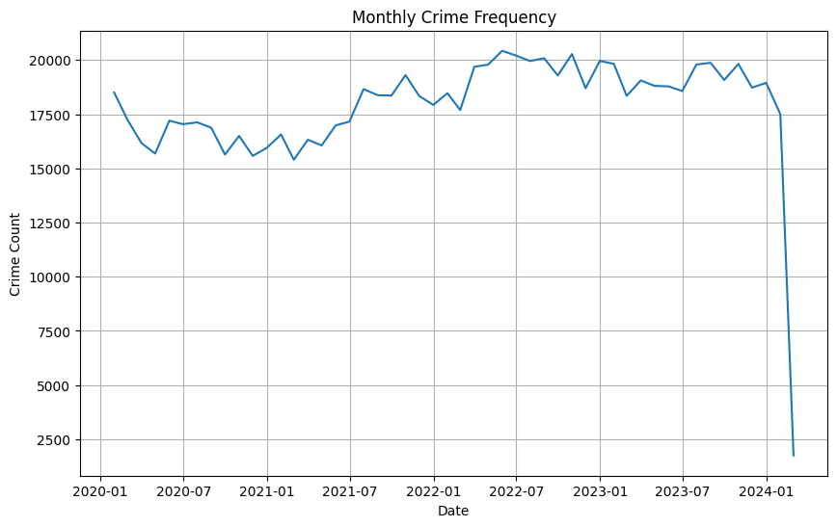
Monthly Crime Frequency
Time Series Analysis

Slide 21
Monthly Crime Frequency
Time Series Analysis

Slide 22
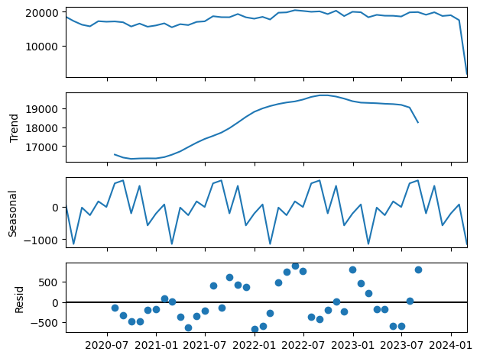
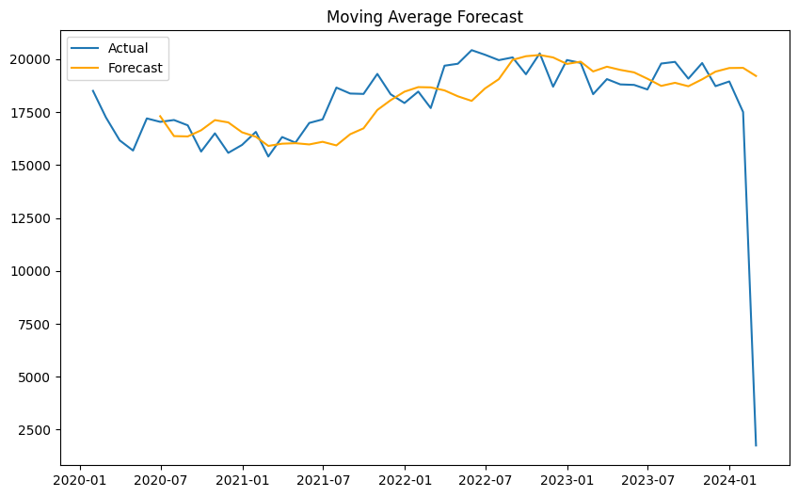
Moving Average Forecast
time series to see trend, seasonality, and residuals
Usinng seasonalDecompose

Slide 23
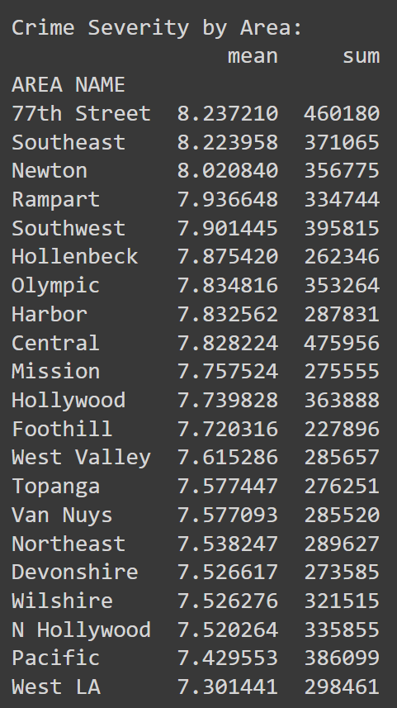
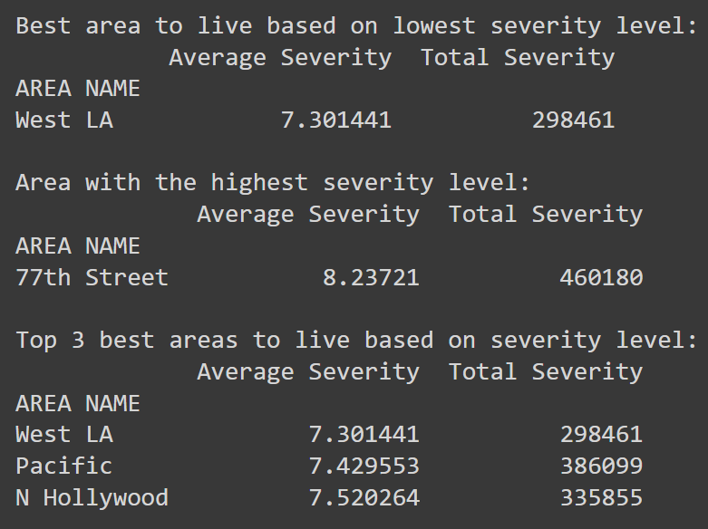
Final Analysis

